Slide 2
solve various problems relating to pipes and cisterns.

Slide 3
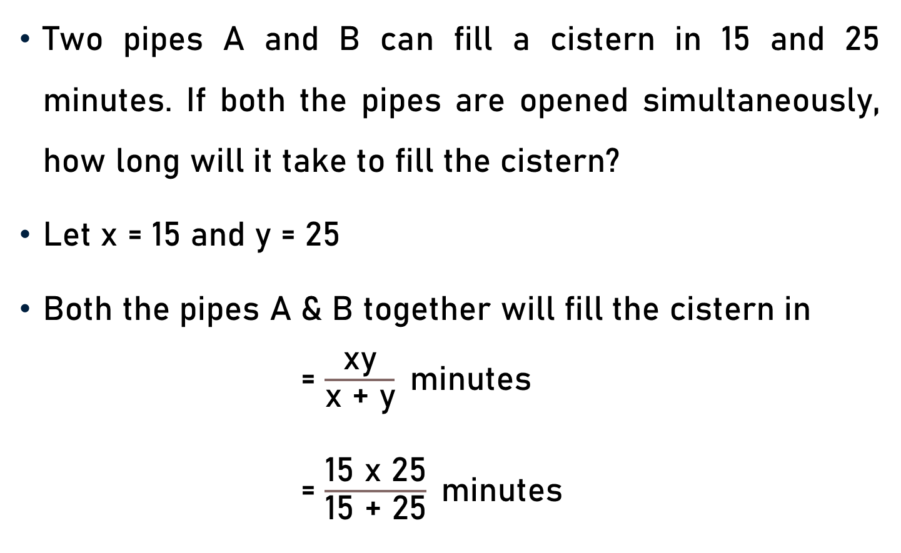
Problem 1
Two pipes A and B can fill a cistern in 15 and 25 minutes. If both the pipes are opened simultaneously, how long will it take to fill the cistern?
Let x = 15 and y = 25
Both the pipes A & B together will fill the cistern in
= $\frac{\text{xy}}{\text{x}\text{ + }\text{y}}$minutes
= $\frac{\text{15 }\text{x}\text{ 25}}{\text{15}\text{ + }\text{25}}$minutes

Slide 4

Problem 1
= $\frac{\text{15 }\text{x}\text{ 25}}{\text{15}\text{ + }\text{25}}$minutes
= $\frac{\text{375}}{\text{40}}$minutes
= $\frac{\text{75}}{\text{8}}$minutes
75
8

Slide 5
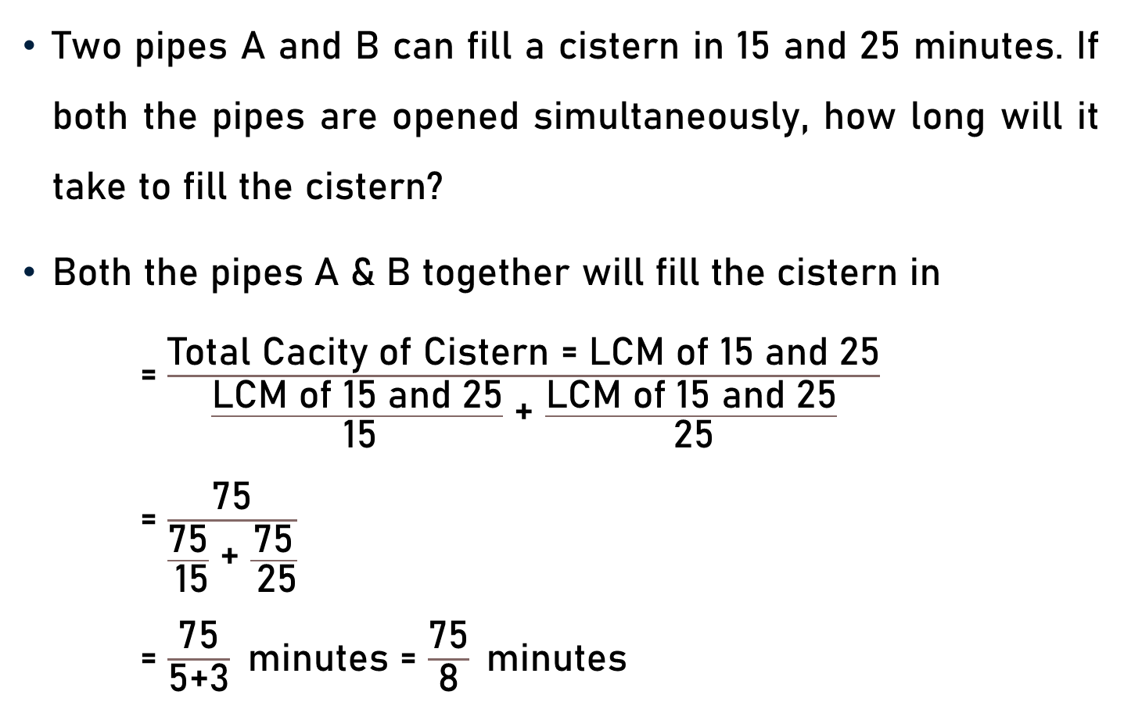
Problem 1 – Alternative Method
Two pipes A and B can fill a cistern in 15 and 25 minutes. If both the pipes are opened simultaneously, how long will it take to fill the cistern?
Both the pipes A & B together will fill the cistern in
= $\frac{\text{Total} \text{Cacity} \text{of} \text{Cistern}\text{ = }\text{LCM} \text{of}\text{ 15 }\text{and}\text{ 25}}{\frac{\text{LCM} \text{of}\text{ 15 }\text{and}\text{ 25}}{ \text{15}}\text{ +} \frac{\text{LCM} \text{of}\text{ 15 }\text{and}\text{ 25}}{ \text{25}}}$
= $\frac{\text{75}}{\frac{\text{7}\text{5}}{ \text{15}}\text{ + }\frac{\text{7}\text{5}}{ \text{25}}}$
= $\frac{\text{75}}{\text{5+}\text{3}}$minutes = $\frac{\text{75}}{\text{8}}$minutes
5
3

Slide 6
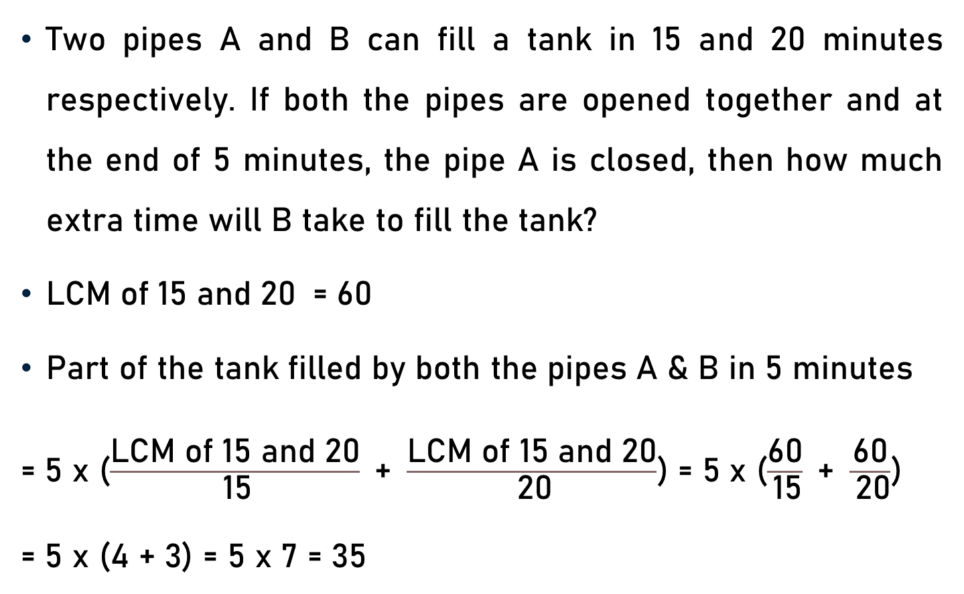
Problem 2
Two pipes A and B can fill a tank in 15 and 20 minutes respectively. If both the pipes are opened together and at the end of 5 minutes, the pipe A is closed, then how much extra time will B take to fill the tank?
$\text{LCM} \text{of}\text{ 15 }\text{and}\text{ 20}$ = 60
Part of the tank filled by both the pipes A & B in 5 minutes
= 5 x ($\frac{\text{LCM} \text{of}\text{ 15 }\text{and}\text{ 20}}{ \text{15}}\text{ + }\frac{\text{LCM} \text{of}\text{ 15 }\text{and}\text{ 20}}{ \text{20}}$) = 5 x ($\frac{\text{60}}{ \text{15}}\text{ + }\frac{\text{60}}{ \text{20}}$)
= 5 x (4 + 3) = 5 x 7 = 35
4
3

Slide 7
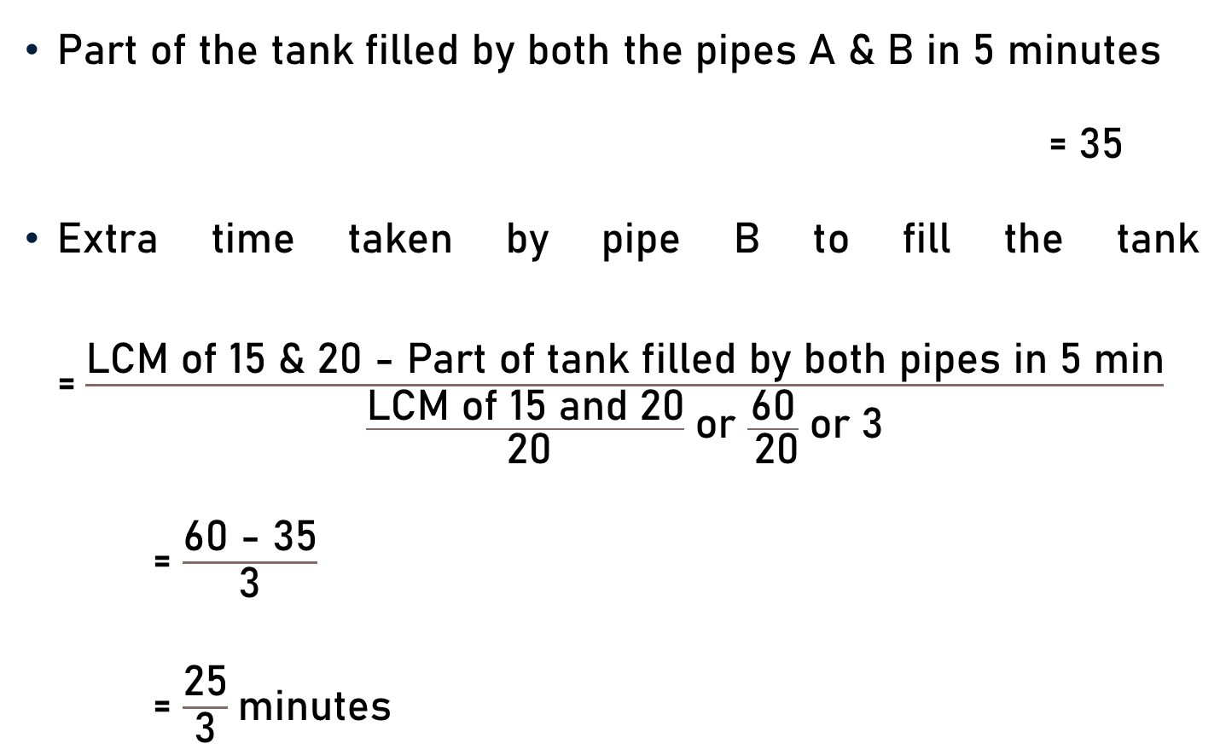
Problem 2
Part of the tank filled by both the pipes A & B in 5 minutes
= 35
Extra time taken by pipe B to fill the tank =$\frac{\text{LCM} \text{of}\text{ 15 \& 20 − }\text{Part} \text{of} \text{t}\text{ank} \text{filled} \text{by} \text{both} \text{pipes} \text{in}\text{ 5 }\text{min}}{\frac{\text{LCM} \text{of}\text{ 15 }\text{and}\text{ 20}}{ \text{20}} \text{or} \frac{\text{60}}{ \text{20}} \text{or} \text{3}}$
= $\frac{\text{60 − 35}}{\text{3}}$
= $\frac{\text{2}\text{5}}{\text{3}}$minutes

Slide 8
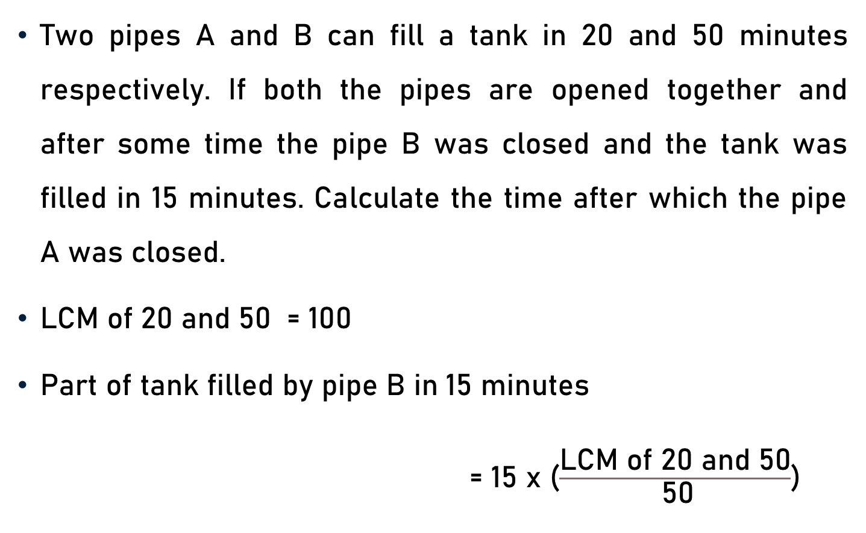
Problem 3
Two pipes A and B can fill a tank in 20 and 50 minutes respectively. If both the pipes are opened together and after some time the pipe B was closed and the tank was filled in 15 minutes. Calculate the time after which the pipe A was closed.
$\text{LCM} \text{of}\text{ 20 }\text{and}\text{ 50}$ = 100
Part of tank filled by pipe B in 15 minutes
= 15 x ($\frac{\text{LCM} \text{of}\text{ 20 }\text{and}\text{ 50}}{ \text{50}}$)

Slide 9
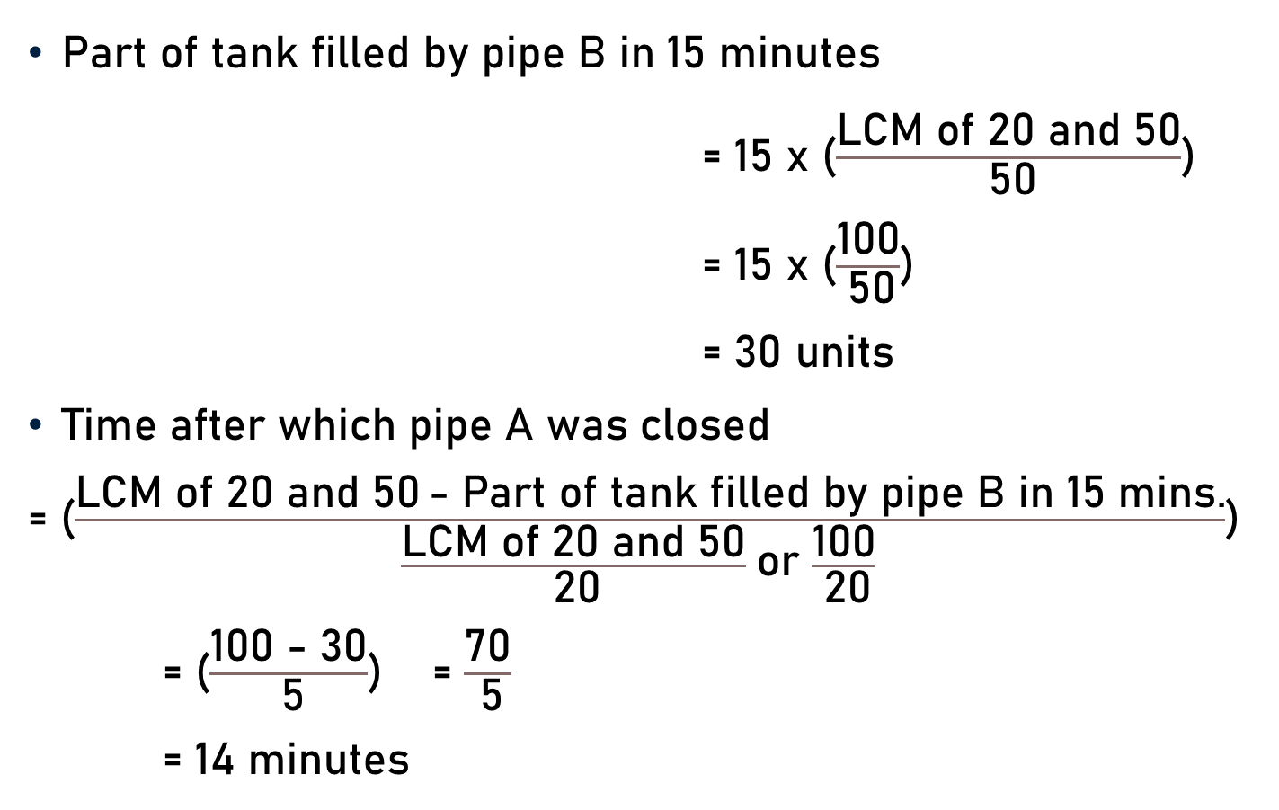
Problem 3
Part of tank filled by pipe B in 15 minutes
= 15 x ($\frac{\text{LCM} \text{of}\text{ 20 }\text{and}\text{ 50}}{ \text{50}}$)
= 15 x ($\frac{\text{100}}{ \text{50}}$)
= 30 units
Time after which pipe A was closed
= ($\frac{\text{LCM} \text{of}\text{ 20 }\text{and}\text{ 50} \text{− }\text{Part} \text{of} \text{tank} \text{filled} \text{by} \text{pipe} \text{B} \text{in}\text{ 15 }\text{mins}\text{.}}{\frac{\text{LCM} \text{of}\text{ 20 }\text{and}\text{ 50}}{ \text{20}} \text{or} \frac{\text{100}}{ \text{20}} }$)
= ($\frac{\text{100}\text{ − }\text{30}}{ \text{5}}$) = $\frac{\text{70}}{ \text{5}}$
= 14 minutes
2
5

Slide 10
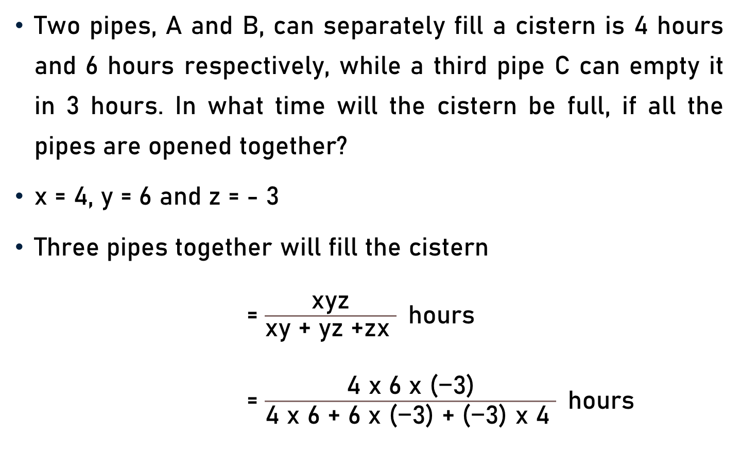
Problem 4
Two pipes, A and B, can separately fill a cistern is 4 hours and 6 hours respectively, while a third pipe C can empty it in 3 hours. In what time will the cistern be full, if all the pipes are opened together?
x = 4, y = 6 and z = - 3
Three pipes together will fill the cistern
= $\frac{\text{xyz}}{\text{xy}\text{ + }\text{yz}\text{ +}\text{zx} }$hours
= $\frac{\text{4 }\text{x}\text{ 6 }\text{x}\text{ (−3)}}{\text{4 }\text{x}\text{ 6}\text{ + }\text{6 }\text{x}\text{ (−3) + (−3) }\text{x}\text{ 4} }$hours

Slide 11


Problem 4
= $\frac{\text{4 }\text{x}\text{ 6 }\text{x}\text{ (−3)}}{\text{4 }\text{x}\text{ 6}\text{ + }\text{6 }\text{x}\text{ (−3) + (−3) }\text{x}\text{ 4} }$hours
= $\frac{\text{−72}}{\text{24 − 18} \text{−} \text{12} }$hours
= $\frac{\text{− }\text{72}}{\text{− 6} }$hours
=$\text{1}\text{2}$ hours
Alternative Method
LCM of 4, 6, and 3
= 12 (Total Capacity)
$\frac{\text{1}\text{2}}{\text{4} }$= 3, $\frac{\text{1}\text{2}}{\text{6} }$ = 2, & $\frac{\text{1}\text{2}}{\text{− }\text{3} }$ = - 4
Cistern will be filled in
= $\frac{\text{1}\text{2}}{\text{3 + 2 − 4} }$
= $\frac{\text{12}}{\text{5}\text{− 4} }$
= 12 hours
12

Slide 12
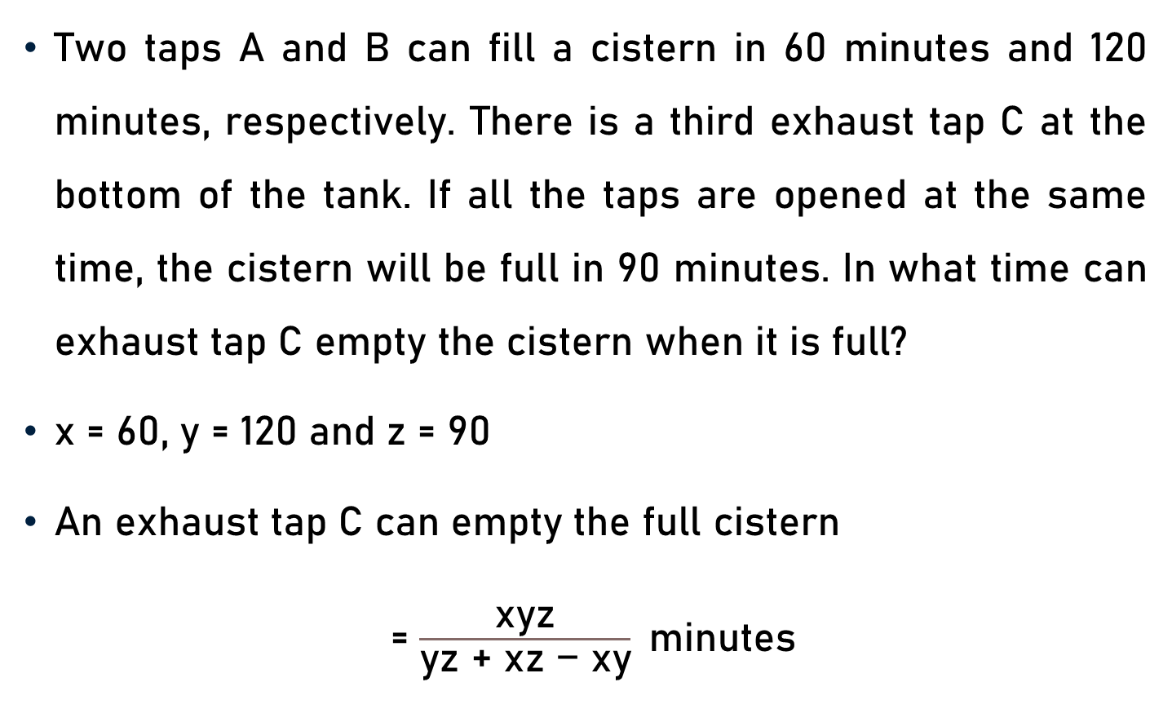
Problem 5
Two taps A and B can fill a cistern in 60 minutes and 120 minutes, respectively. There is a third exhaust tap C at the bottom of the tank. If all the taps are opened at the same time, the cistern will be full in 90 minutes. In what time can exhaust tap C empty the cistern when it is full?
x = 60, y = 120 and z = 90
An exhaust tap C can empty the full cistern
= $\frac{\text{xyz}}{\text{yz}\text{ + }\text{xz}\text{ − }\text{xy}}$minutes

Slide 13
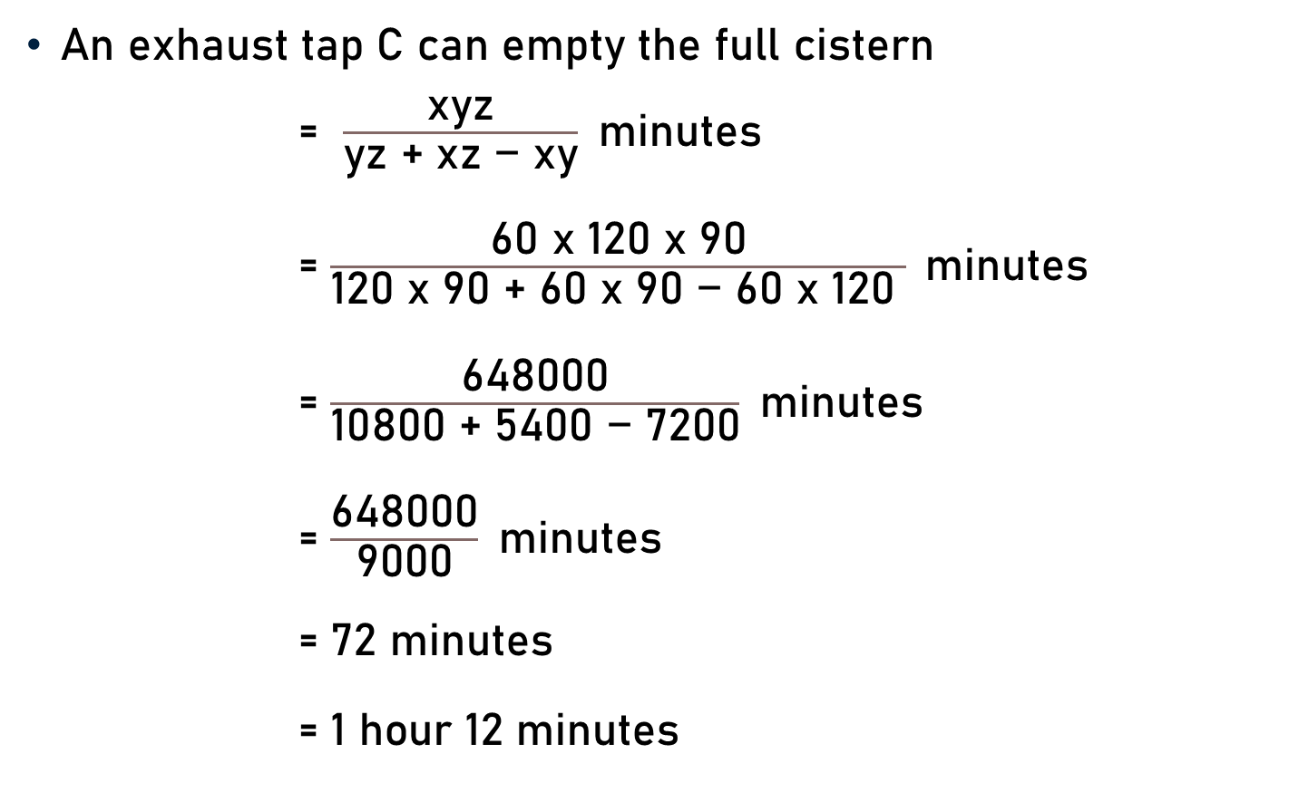
Problem 5
An exhaust tap C can empty the full cistern
= $\frac{\text{xyz}}{\text{yz}\text{ + }\text{xz}\text{ − }\text{xy}}$minutes
= $\frac{\text{60} \text{x}\text{ 120 }\text{x}\text{ 90}}{\text{120} \text{x}\text{ 90}\text{ + }\text{6}\text{0} \text{x}\text{ 90 − 60 }\text{x}\text{ 120} } \text{minutes}$
= $\frac{\text{648000}}{\text{10800 }\text{+ }\text{5400 }\text{− }\text{72}\text{0}\text{0}}$minutes
= $\frac{\text{648000}}{\text{9000}}$minutes
= $\text{7}\text{2}$ minutes
= $\text{1 }\text{hour}\text{ 12}$ minutes
72

Slide 14
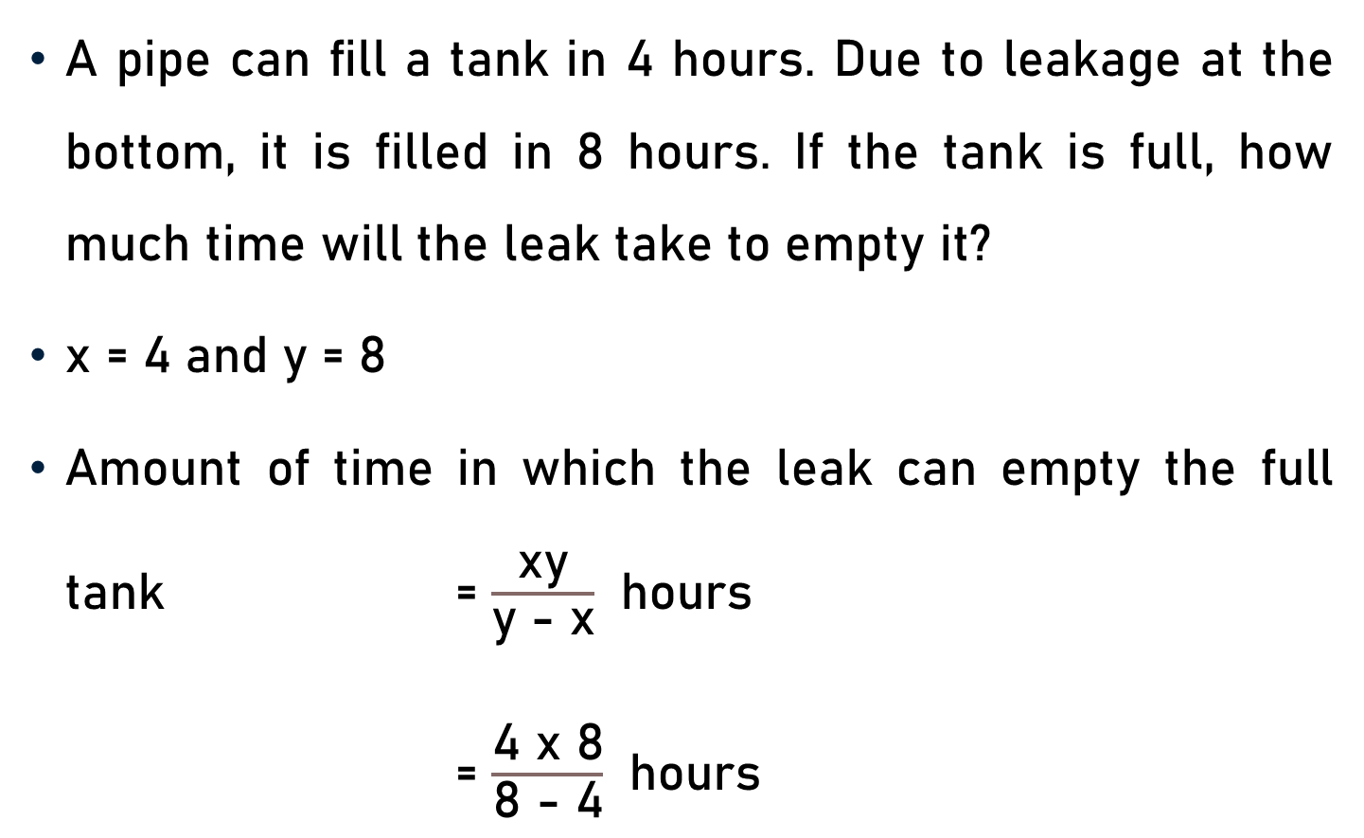
Problem 6
A pipe can fill a tank in 4 hours. Due to leakage at the bottom, it is filled in 8 hours. If the tank is full, how much time will the leak take to empty it?
x = 4 and y = 8
Amount of time in which the leak can empty the full tank = $\frac{\text{x}\text{y}}{\text{y} \text{−} \text{x}}$ hours
= $\frac{\text{4 }\text{x}\text{ 8}}{\text{8} \text{−} \text{4}}$ hours

Slide 15

Problem 6
Amount of time in which leak can empty the full tank = $\frac{\text{x}\text{y}}{\text{y} \text{−} \text{x}}$ hours
= $\frac{\text{4 }\text{x}\text{ 8}}{\text{8} \text{−} \text{4}}$ hours
= $\frac{\text{32}}{\text{4}}$ hours
= $\text{8}$hours
8

Slide 16
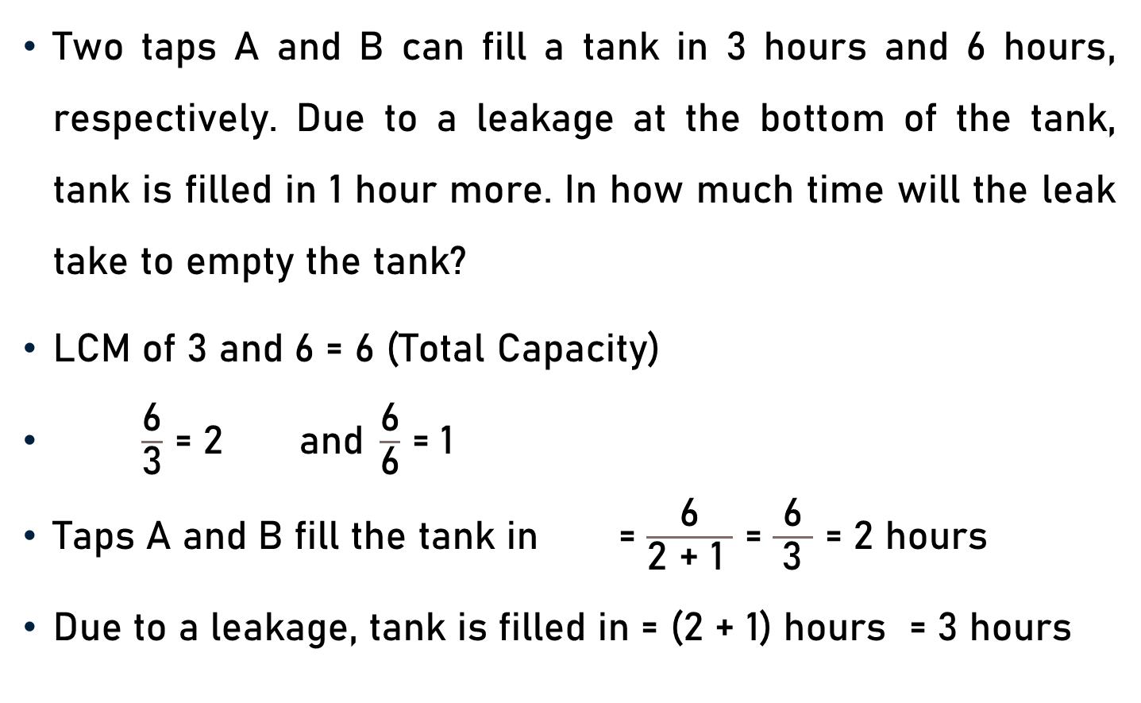
Problem 7
Two taps A and B can fill a tank in 3 hours and 6 hours, respectively. Due to a leakage at the bottom of the tank, tank is filled in 1 hour more. In how much time will the leak take to empty the tank?
LCM of 3 and 6 = 6 (Total Capacity)
$\frac{\text{6}}{\text{3}}$ = 2 and $\frac{\text{6}}{\text{6}}$ = 1
Taps A and B fill the tank in = $\frac{\text{6}}{\text{2 + 1} }$ = $\frac{\text{6}}{ \text{3} }$ = 2 hours
Due to a leakage, tank is filled in = (2 + 1) hours = 3 hours

Slide 17
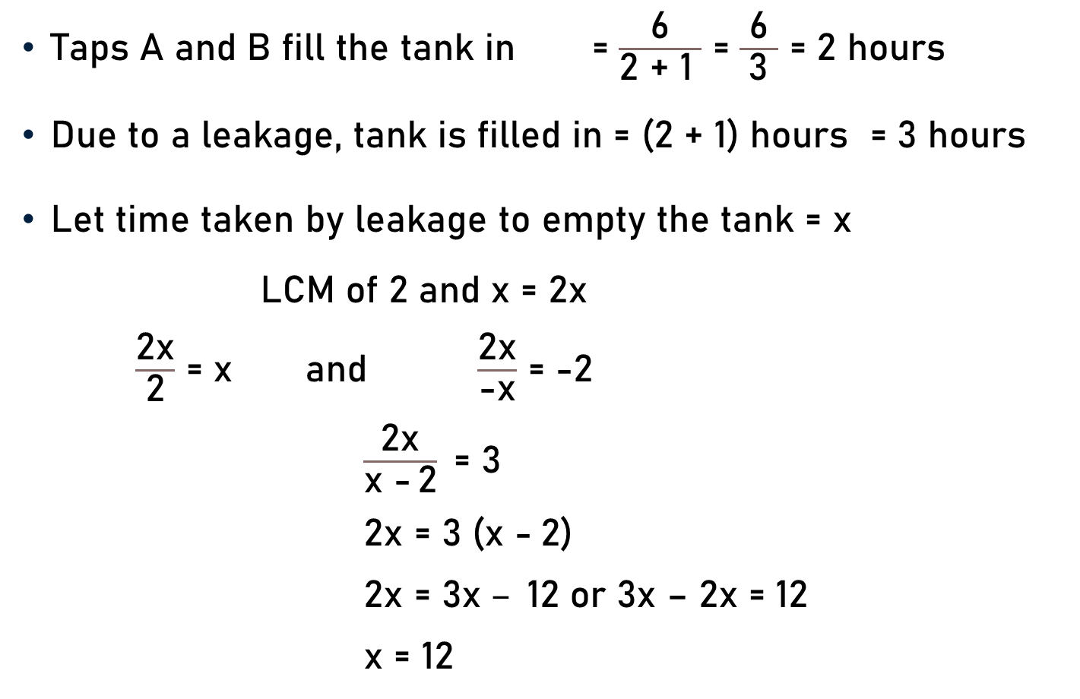
Problem 7
Taps A and B fill the tank in = $\frac{\text{6}}{\text{2 + 1} }$ = $\frac{\text{6}}{ \text{3} }$ = 2 hours
Due to a leakage, tank is filled in = (2 + 1) hours = 3 hours
Let time taken by leakage to empty the tank = x
LCM of 2 and x = 2x
$\frac{\text{2}\text{x}}{\text{2}}$ = x and $\frac{\text{2}\text{x}}{\text{−}\text{x}}$ = -2
$\frac{\text{2}\text{x}}{\text{x}\text{ −} \text{2}}\text{ = }\text{3}$
$\text{2}\text{x}$ $\text{= 3}$ ($\text{x} \text{−} \text{2)}$
$\text{2}\text{x}$ $\text{= 3}\text{x} – \text{12}$ or 3x – 2x = 12
x = 12

Slide 18
Problem 8
An inlet pipe fills water in a tank at the rate of 12 litres per minute. A leak at the bottom of a tank can empty the full tank in 18 hours. When the tank is full, the inlet is opened and due to leak, the tank is empty in 24 hours. Find out the capacity of the tank.
x = 18 hours
y = 12 = 12 x 60 litres per hours
= 720 litres per hours
z = 24 hours

Slide 19
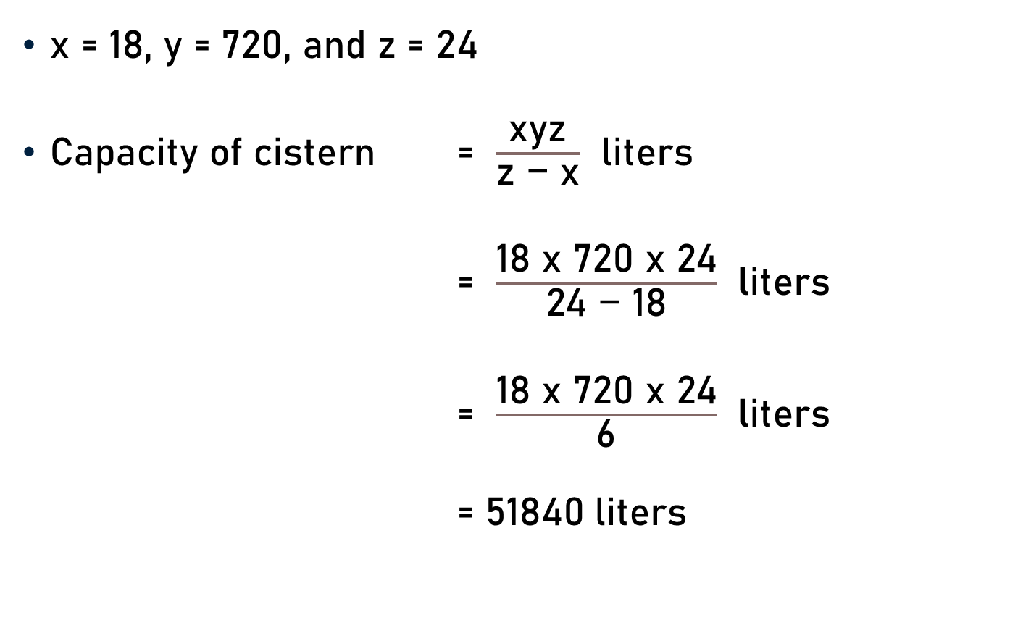
Problem 8
x = 18, y = 720, and z = 24
Capacity of cistern = $\frac{\text{x}\text{yz}}{\text{z}\text{ − }\text{x}}$ liters
= $\frac{\text{18} \text{x}\text{ 720 }\text{x}\text{ 24}}{\text{24}\text{ − }\text{18}}$ liters
= $\frac{\text{18 }\text{x}\text{ 720 }\text{x}\text{ 24}}{\text{6}}$ liters
= $\text{5184}\text{0}$liters
4

Slide 20
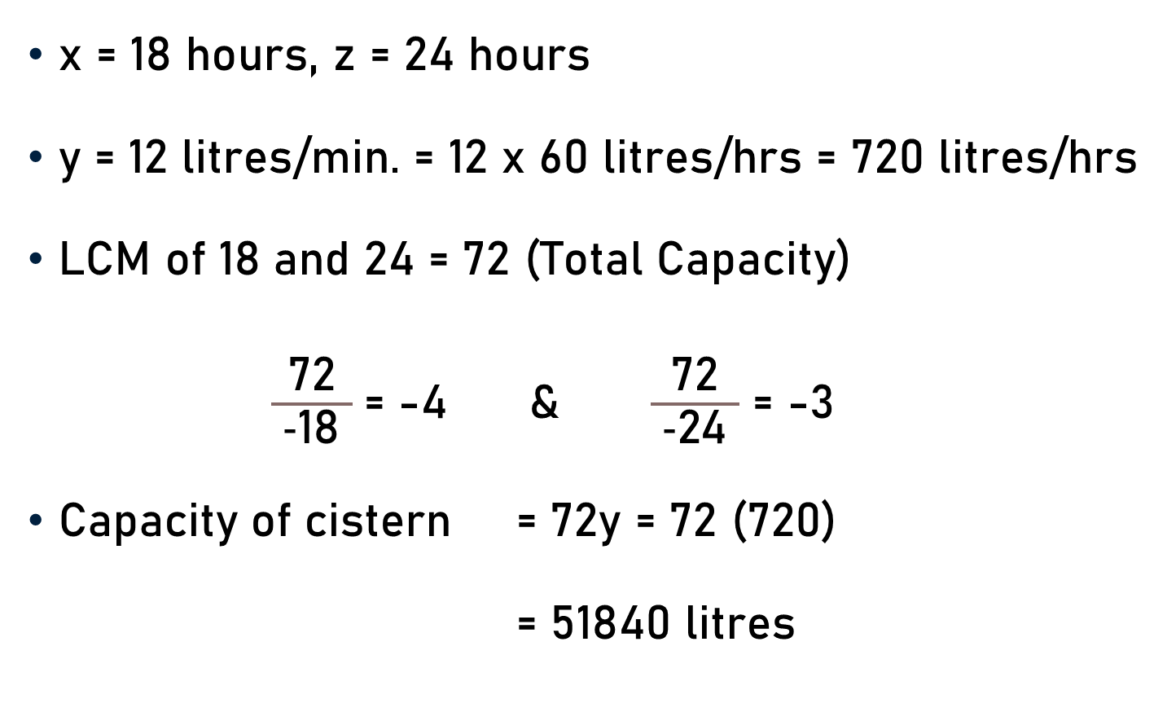
Problem 8 - Alternative Method
x = 18 hours, z = 24 hours
y = 12 litres/min. = 12 x 60 litres/hrs = 720 litres/hrs
LCM of 18 and 24 = 72 (Total Capacity)
$\frac{\text{7}\text{2}}{\text{ −}\text{18} }$= -4 & $\frac{\text{7}\text{2}}{\text{ −}\text{24} }$ = -3
Capacity of cistern = 72y = 72 (720)
= 51840 litres
4
3

Slide 21
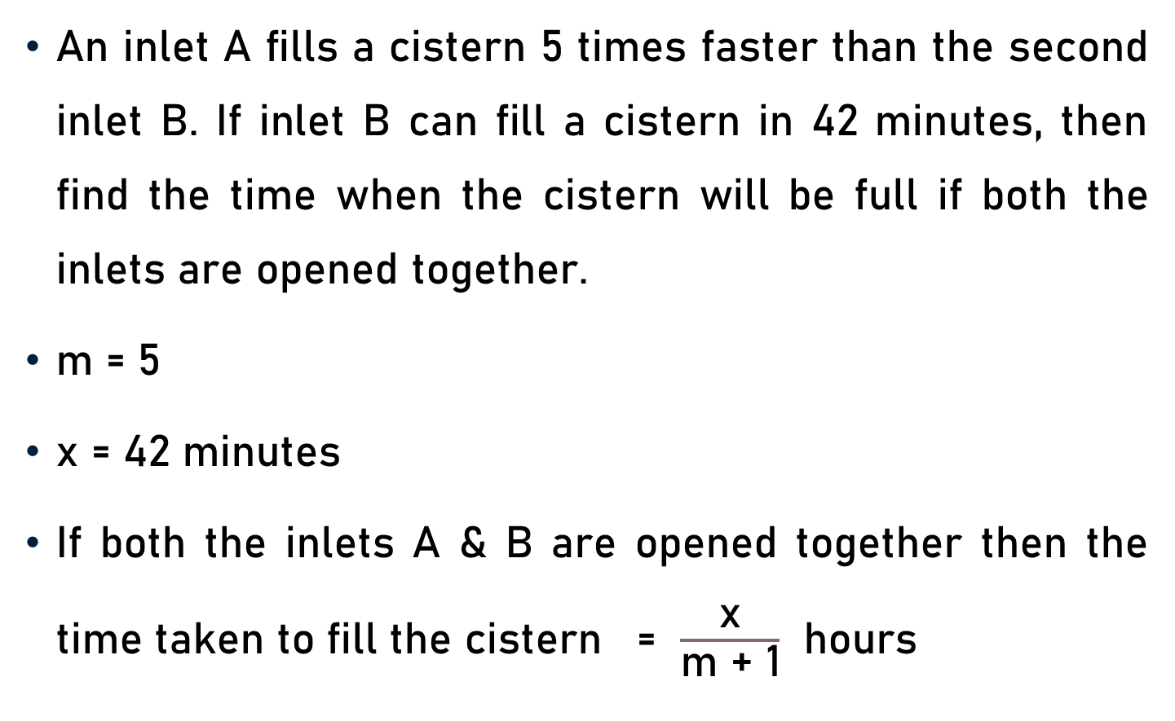
Problem 9
An inlet A fills a cistern 5 times faster than the second inlet B. If inlet B can fill a cistern in 42 minutes, then find the time when the cistern will be full if both the inlets are opened together.
m = 5
x = 42 minutes
If both the inlets A & B are opened together then the time taken to fill the cistern = $\frac{\text{x}}{\text{m}\text{ + 1}}$ hours

Slide 22
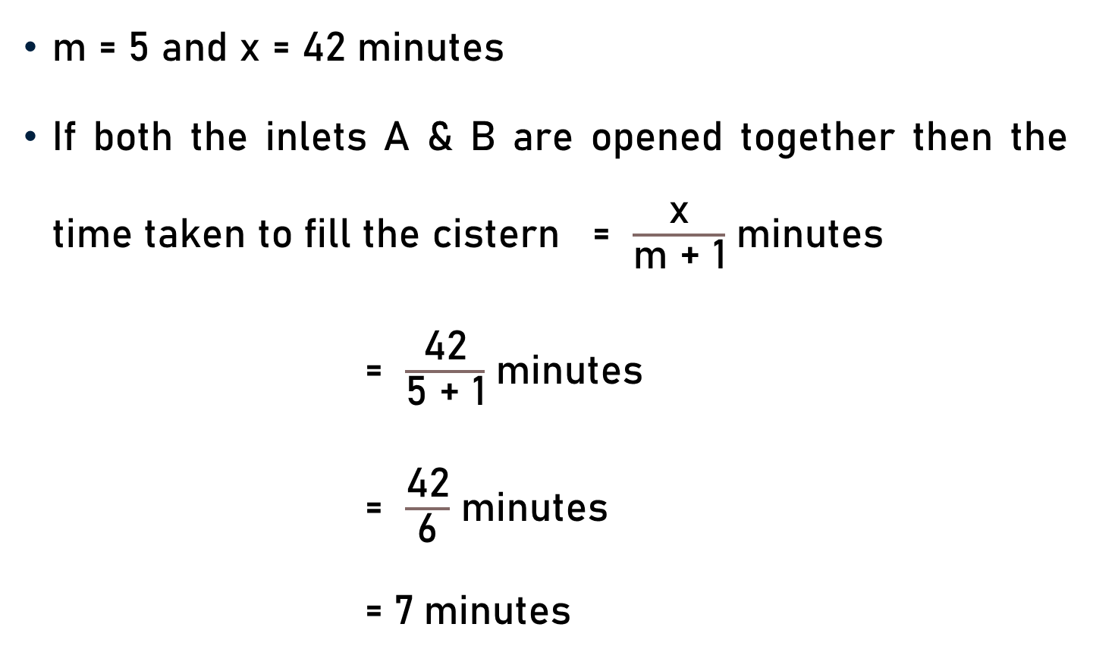
Problem 9
m = 5 and x = 42 minutes
If both the inlets A & B are opened together then the time taken to fill the cistern = $\frac{\text{x}}{\text{m}\text{ + 1}}$ minutes
= $\frac{\text{42}}{\text{5}\text{ + 1}}$ minutes
= $\frac{\text{42}}{\text{6}}$ minutes
= $\text{7}$minutes
7

Slide 23

Problem 10
An inlet A fills a cistern 5 times faster than the second inlet B. If inlet A can fill a cistern in 42 minutes, then find the time when the cistern will be full if both the inlets are opened together.
m = 5
y = 42 minutes
If both the inlets A & B are opened together then the time taken to fill the cistern = {$\frac{\text{m}}{\text{m}\text{ + 1}}$}y hours

Slide 24
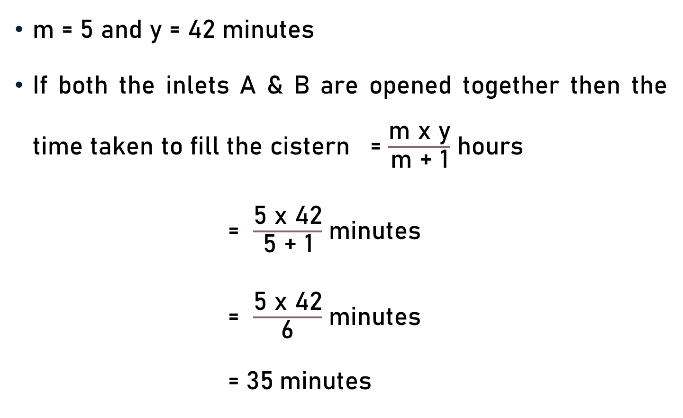
Problem 10
m = 5 and y = 42 minutes
If both the inlets A & B are opened together then the time taken to fill the cistern = $\frac{\text{m} \text{x} \text{y}}{\text{m}\text{ + 1}}$ hours
= $\frac{\text{5} \text{x}\text{ 42}}{\text{5}\text{ + 1}}$ minutes
= $\frac{\text{5 }\text{x}\text{ 42}}{\text{6}}$ minutes
= $\text{35}$minutes
7

Slide 25
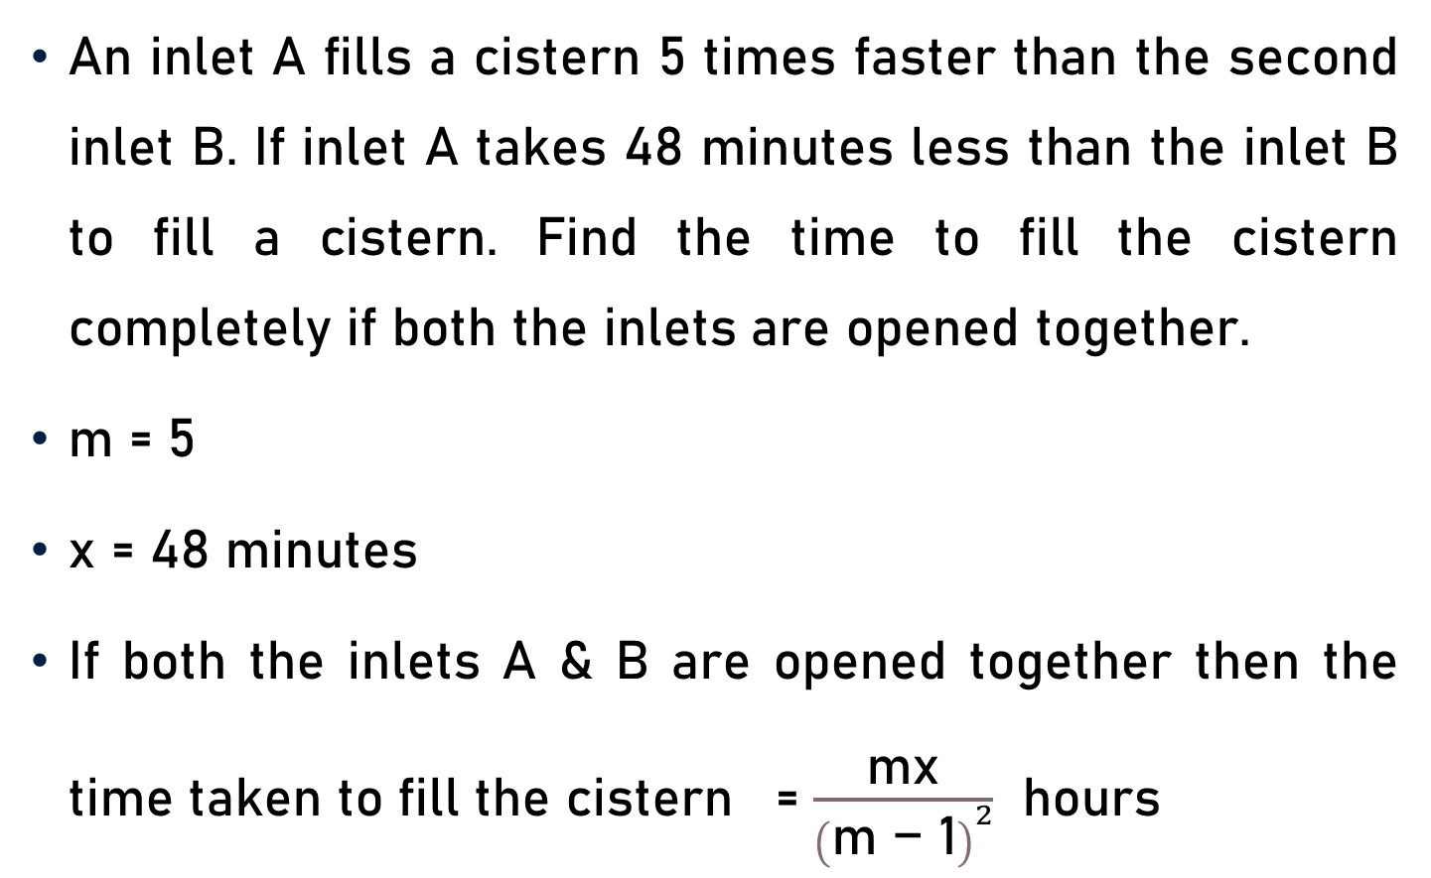
Problem 11
An inlet A fills a cistern 5 times faster than the second inlet B. If inlet A takes 48 minutes less than the inlet B to fill a cistern. Find the time to fill the cistern completely if both the inlets are opened together.
m = 5
x = 48 minutes
If both the inlets A & B are opened together then the time taken to fill the cistern = $\frac{\text{m}\text{x}}{{\left(\text{m}\text{ − 1}\right)}^{2}}$ hours

Slide 26
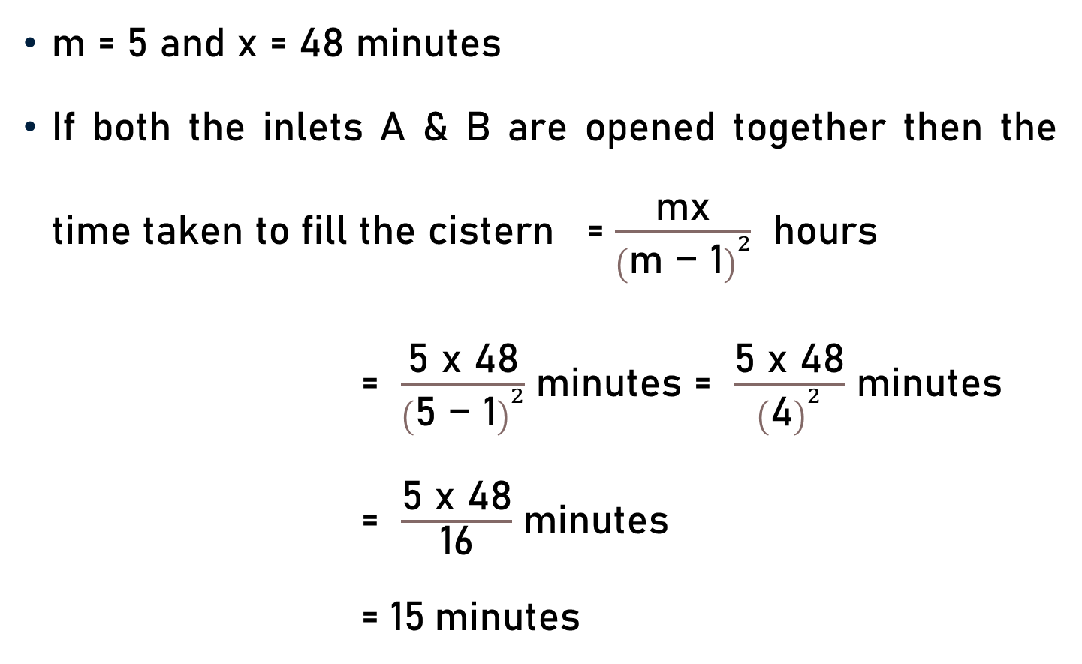
Problem 11
m = 5 and x = 48 minutes
If both the inlets A & B are opened together then the time taken to fill the cistern = $\frac{\text{m}\text{x}}{{\left(\text{m}\text{ − 1}\right)}^{2}}$ hours
= $\frac{\text{5} \text{x}\text{ 48}}{{\left(\text{5}\text{ − 1}\right)}^{2}}$ minutes = $\frac{\text{5 }\text{x}\text{ 48}}{{\left(\text{4}\right)}^{2}}$ minutes
= $\frac{\text{5 }\text{x}\text{ 48}}{\text{16}}$ minutes
= $\text{15}$minutes
3

Slide 27
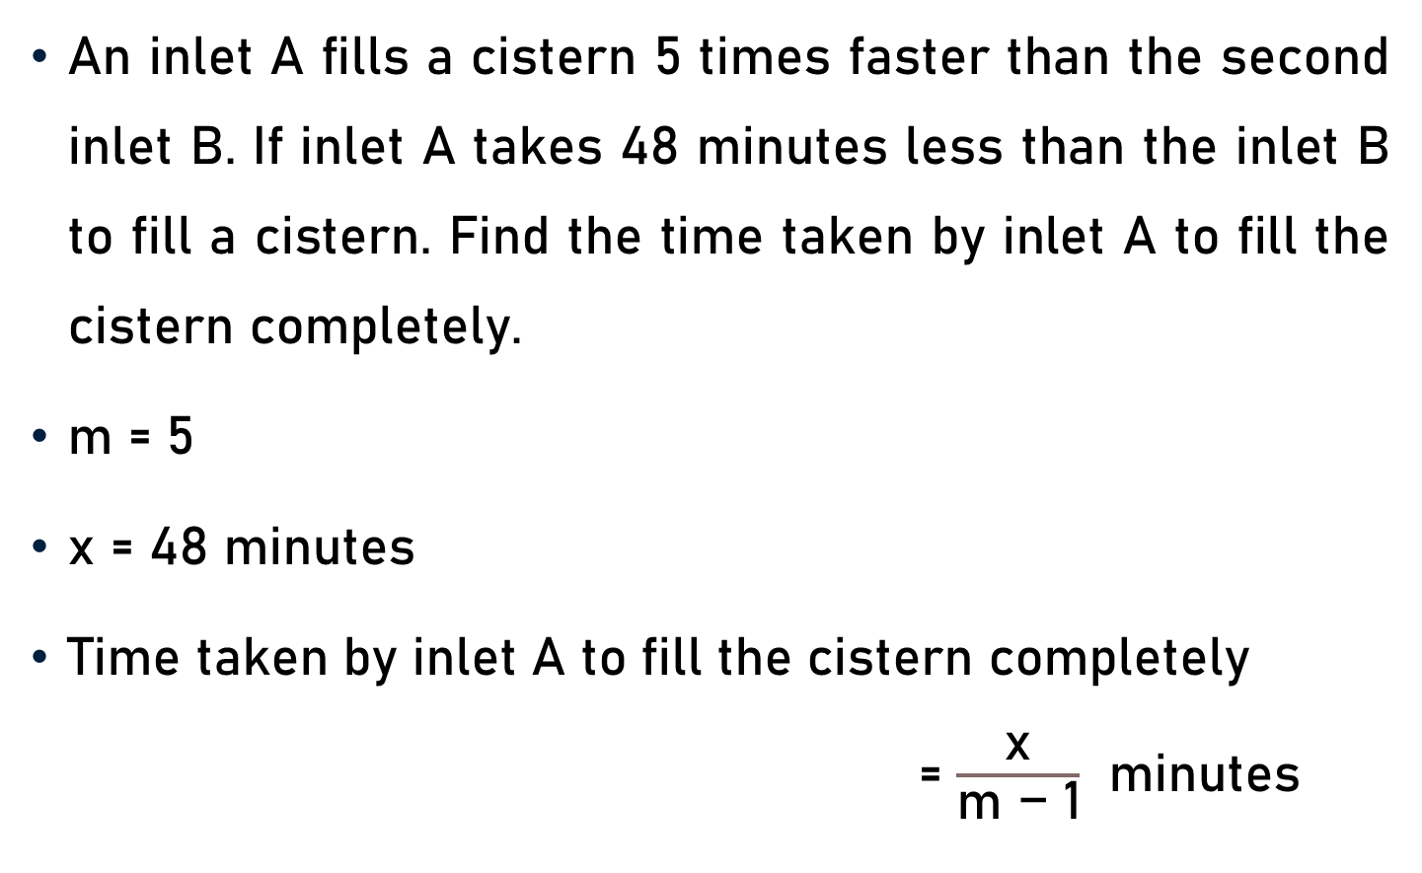
Problem 12
An inlet A fills a cistern 5 times faster than the second inlet B. If inlet A takes 48 minutes less than the inlet B to fill a cistern. Find the time taken by inlet A to fill the cistern completely.
m = 5
x = 48 minutes
Time taken by inlet A to fill the cistern completely = $\frac{\text{x}}{\text{m}\text{ − 1}}$ minutes

Slide 28
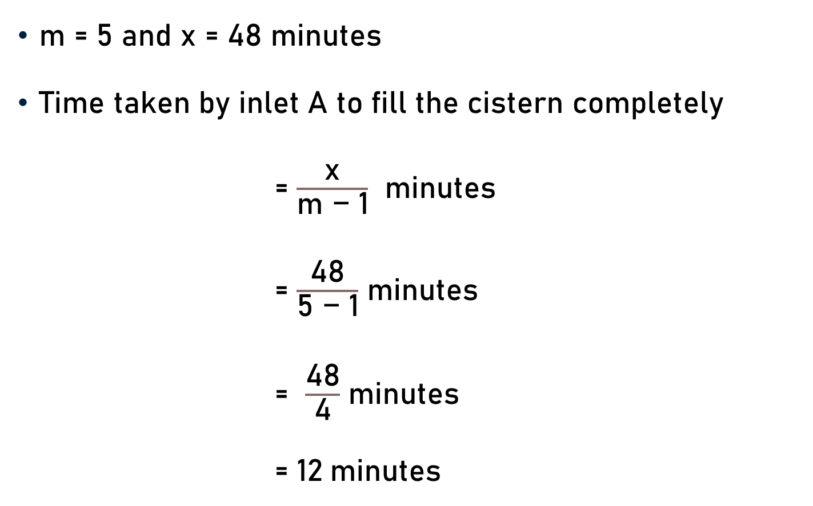
Problem 12
m = 5 and x = 48 minutes
Time taken by inlet A to fill the cistern completely
= $\frac{\text{x}}{\text{m}\text{ − 1}}$ minutes
= $\frac{\text{48}}{\text{5}\text{ − 1}}$ minutes
= $\frac{\text{48}}{\text{4}}$ minutes
= $\text{12}$minutes
12

Slide 29
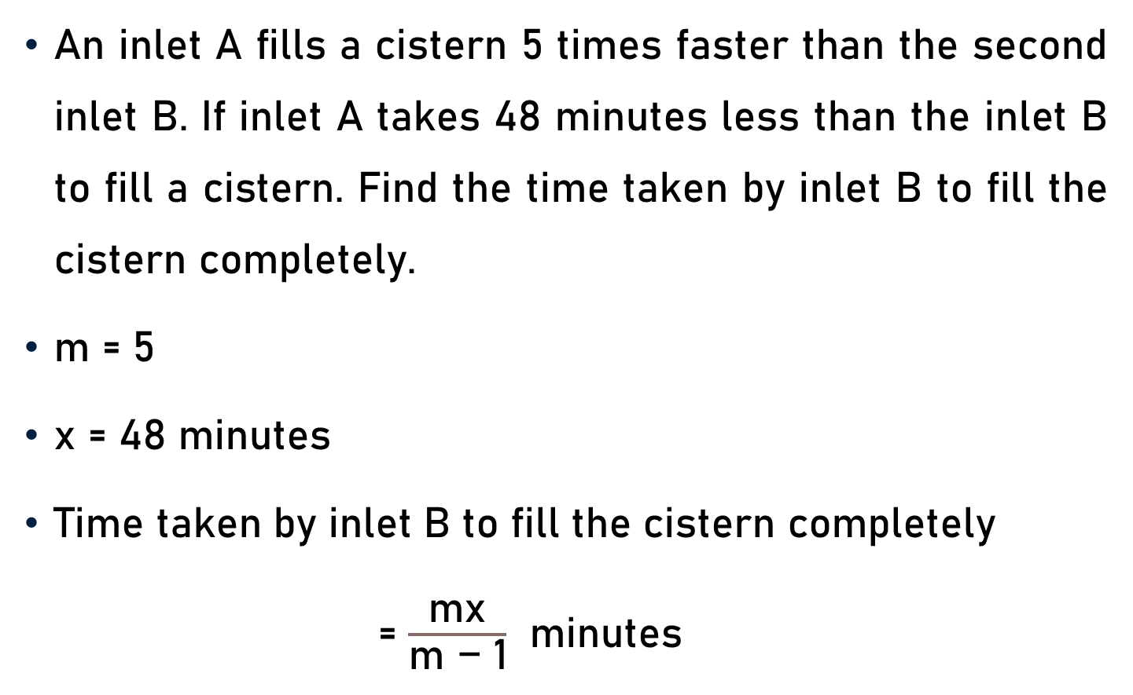
Problem 13
An inlet A fills a cistern 5 times faster than the second inlet B. If inlet A takes 48 minutes less than the inlet B to fill a cistern. Find the time taken by inlet B to fill the cistern completely.
m = 5
x = 48 minutes
Time taken by inlet B to fill the cistern completely
= $\frac{\text{mx}}{\text{m}\text{ − 1}}$ minutes

Slide 30
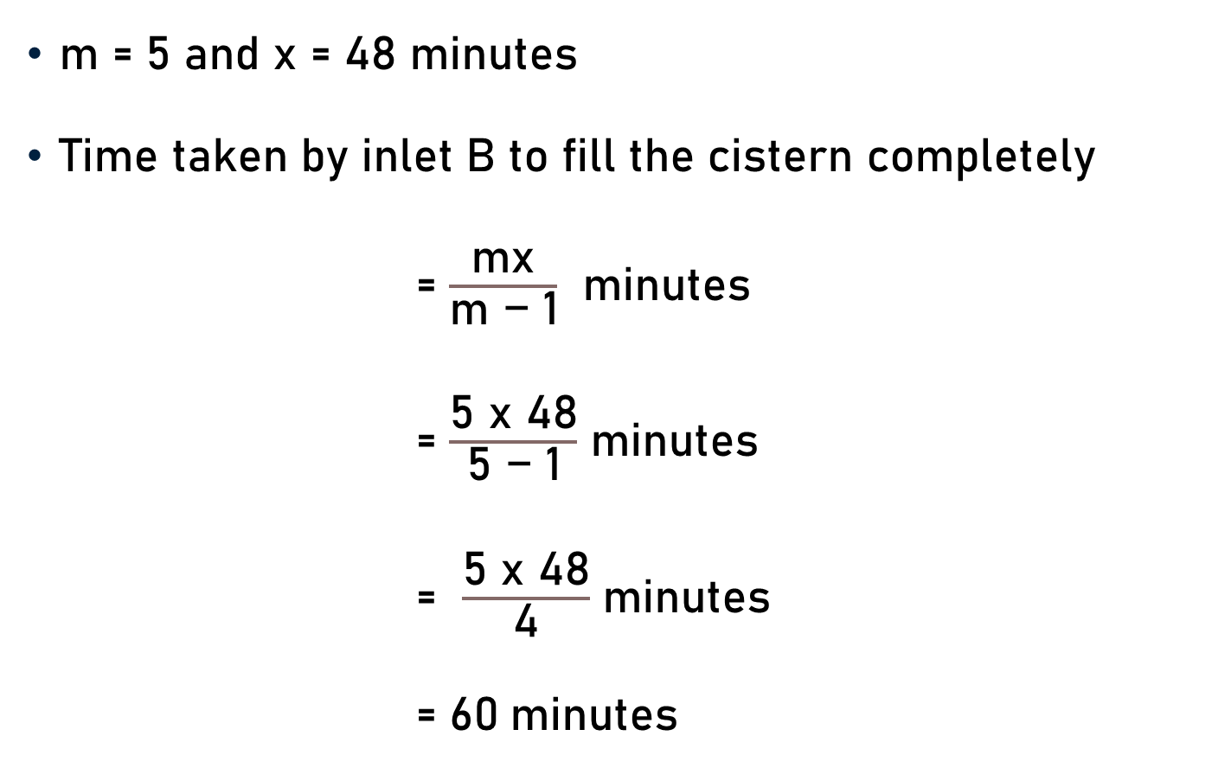
Problem 13
m = 5 and x = 48 minutes
Time taken by inlet B to fill the cistern completely
= $\frac{\text{mx}}{\text{m}\text{ − 1}}$ minutes
= $\frac{\text{5} \text{x}\text{ 48}}{\text{5}\text{ − 1}}$ minutes
= $\frac{\text{5 }\text{x}\text{ 48}}{\text{4}}$ minutes
= $\text{60}$minutes
12

Slide 31
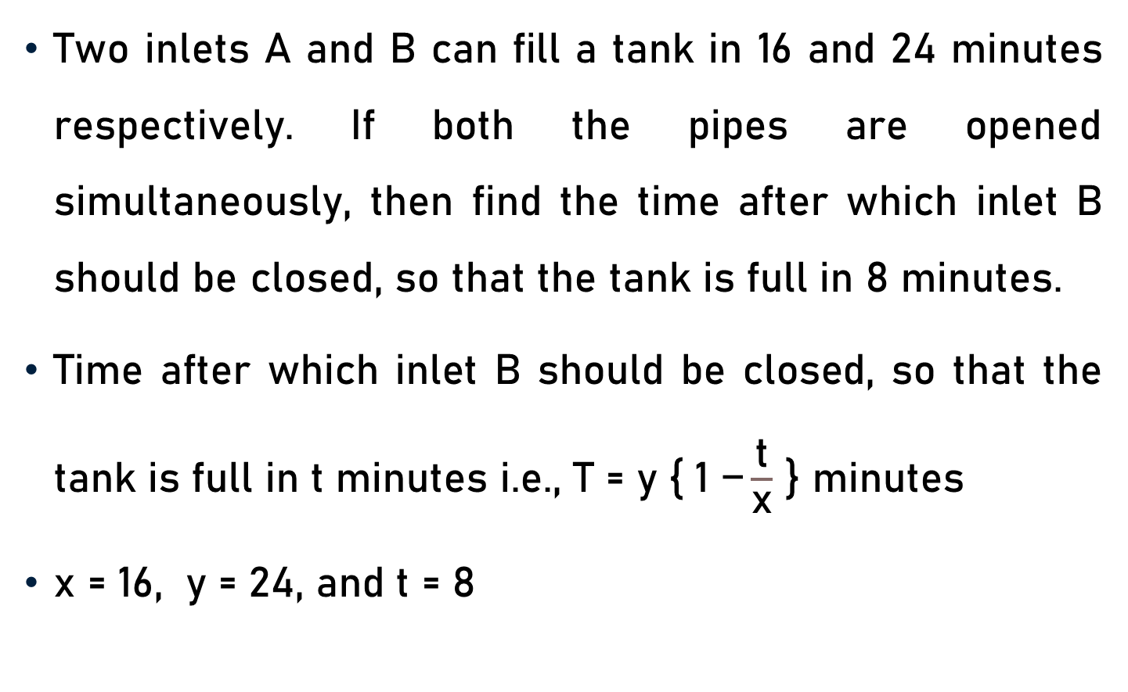
Problem 14
Two inlets A and B can fill a tank in 16 and 24 minutes respectively. If both the pipes are opened simultaneously, then find the time after which inlet B should be closed, so that the tank is full in 8 minutes.
Time after which inlet B should be closed, so that the tank is full in t minutes i.e., $\text{T}\text{ = }\text{y}\text{ \{ 1} \text{−}\frac{\text{t}}{\text{x}}$ } minutes
x = 16, y = 24, and t = 8

Slide 32
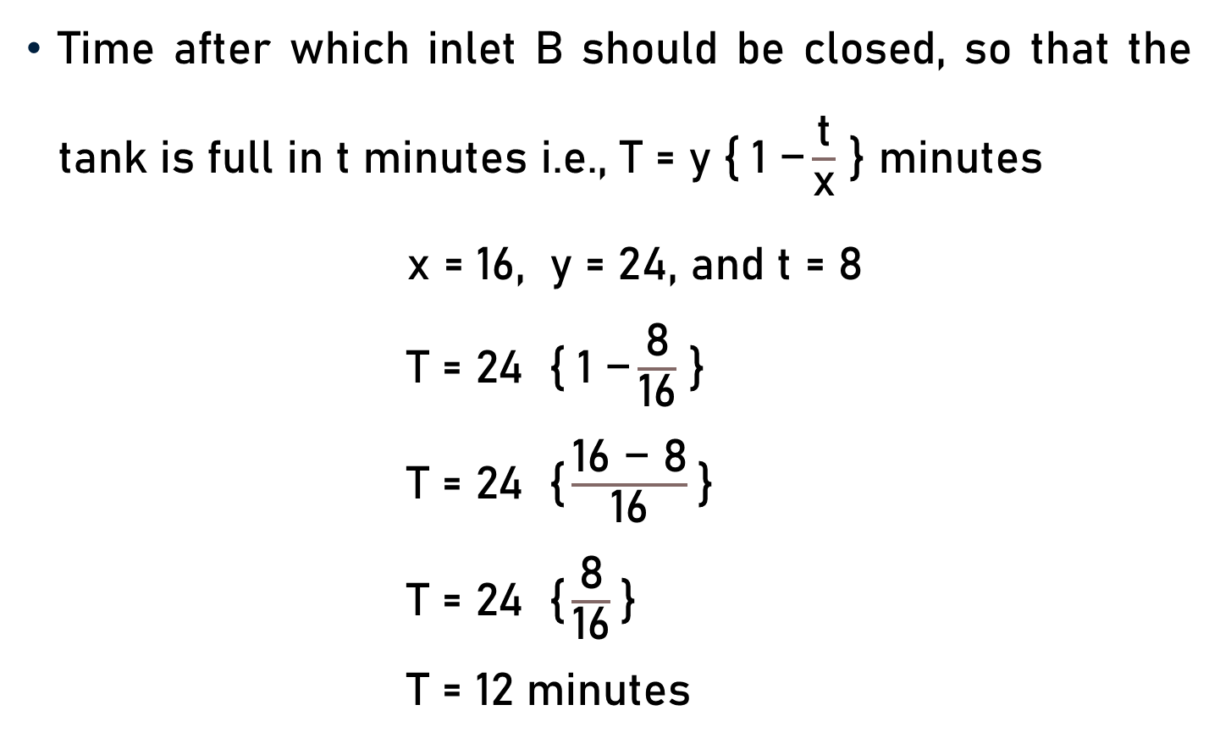
Problem 14
Time after which inlet B should be closed, so that the tank is full in t minutes i.e., $\text{T}\text{ = }\text{y} \text{\{} \text{1} \text{−}\frac{\text{t}}{\text{x}}$ } minutes
x = 16, y = 24, and t = 8
$\text{T}\text{ = 24 \{ 1} \text{−}\frac{\text{8}}{\text{16}}$ }
$\text{T}\text{ = 24 \{}\frac{\text{1}\text{6} \text{−}\text{ 8}}{\text{1}\text{6}}$}
$\text{T}\text{ = 24 \{}\frac{\text{8}}{\text{1}\text{6}}$}
$\text{T}\text{ = 12 }\text{minutes}$
12
2

Slide 33
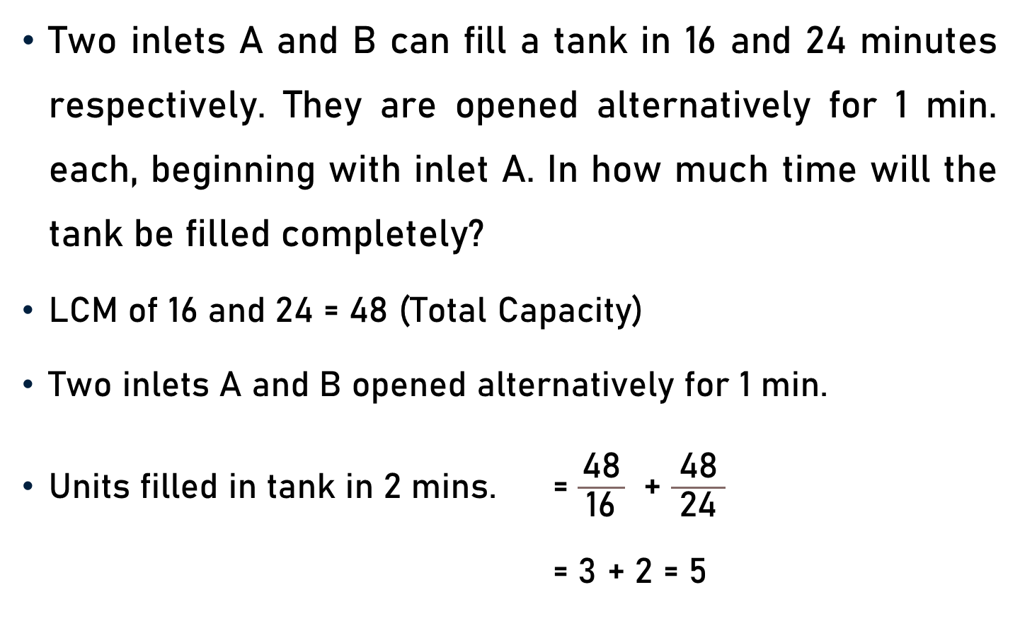
Problem 15
Two inlets A and B can fill a tank in 16 and 24 minutes respectively. They are opened alternatively for 1 min. each, beginning with inlet A. In how much time will the tank be filled completely?
LCM of 16 and 24 = 48 (Total Capacity)
Two inlets A and B opened alternatively for 1 min.
Units filled in tank in 2 mins. = $\frac{\text{48}}{ \text{16} }$ + $\frac{\text{48}}{ \text{24} }$
= 3 + 2 = 5
3
2

Slide 34
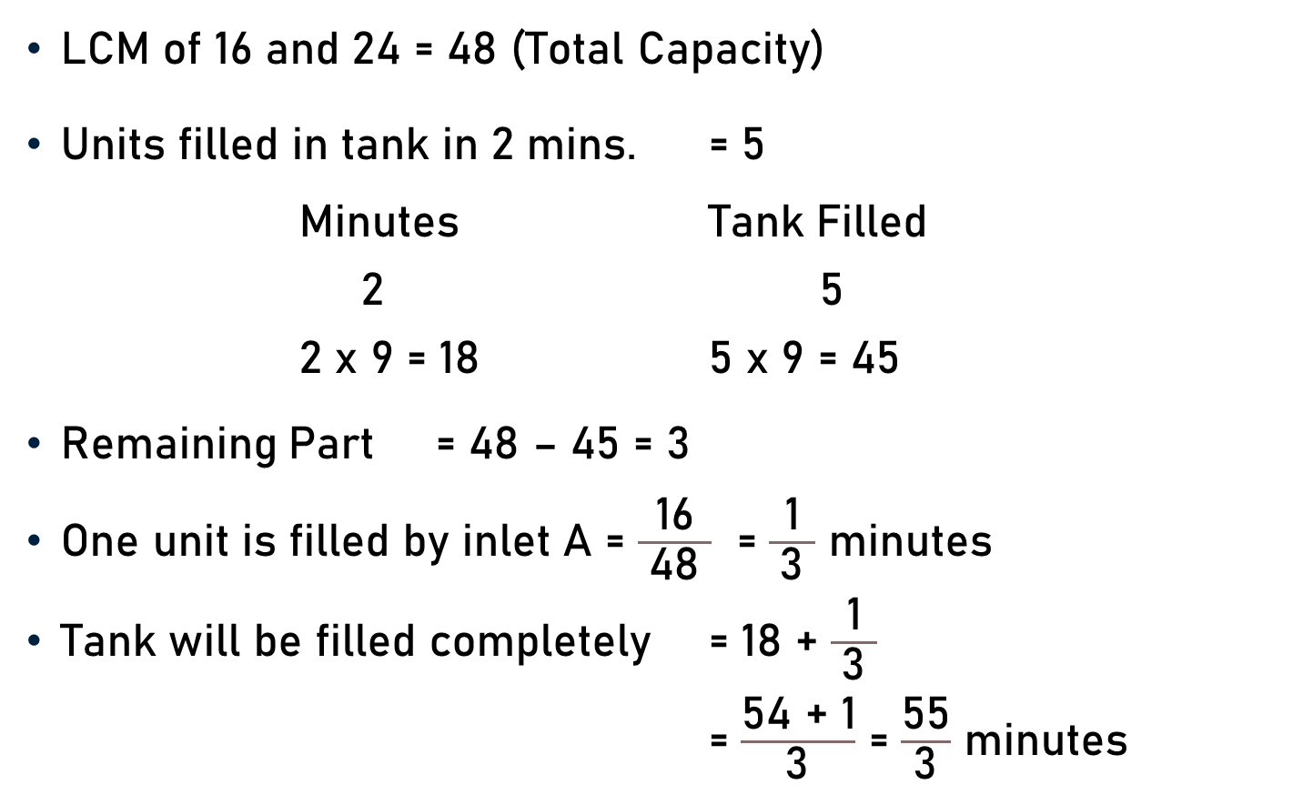
Problem 15
LCM of 16 and 24 = 48 (Total Capacity)
Units filled in tank in 2 mins. = 5
Minutes Tank Filled
2 5
2 x 9 = 18 5 x 9 = 45
Remaining Part = 48 – 45 = 3
One unit is filled by inlet A = $\frac{\text{16}}{ \text{48} }$ = $\frac{\text{1}}{ \text{3} }$ minutes
Tank will be filled completely = 18 + $\frac{\text{1}}{ \text{3} }$
= $\frac{\text{54 + 1}}{ \text{3} }$ = $\frac{\text{55}}{ \text{3} }$ minutes

Slide 35
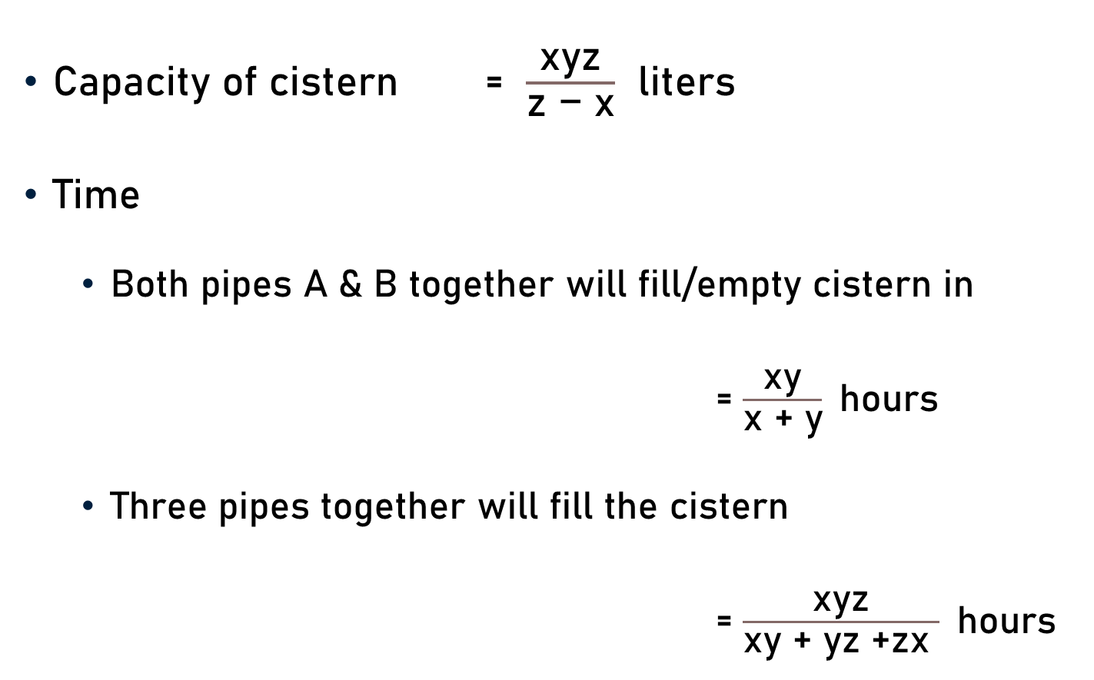
Conclusion
Capacity of cistern = $\frac{\text{x}\text{yz}}{\text{z}\text{ − }\text{x}}$ liters
Time
  Both pipes A & B together will fill/empty cistern in
  = $\frac{\text{xy}}{\text{x}\text{ + }\text{y}}$hours
  Three pipes together will fill the cistern
  = $\frac{\text{xyz}}{\text{xy}\text{ + }\text{yz}\text{ +}\text{zx} }$hours

Slide 36
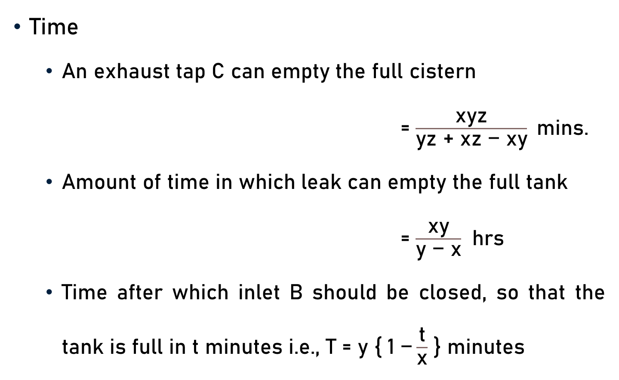
Conclusion
Time
  An exhaust tap C can empty the full cistern
  = $\frac{\text{xyz}}{\text{yz}\text{ + }\text{xz}\text{ − }\text{xy}}$mins.
  Amount of time in which leak can empty the full tank
  = $\frac{\text{x}\text{y}}{\text{y} \text{−} \text{x}}$ hrs
  Time after which inlet B should be closed, so that the tank is full in t minutes i.e., $\text{T}\text{ = }\text{y}\text{ \{ 1} \text{−}\frac{\text{t}}{\text{x}}$ } minutes

Slide 37
Summary
Pipes & Cisterns
  Capacity of Cistern/Tank
  Time – Fill/Empty

